Slide 1
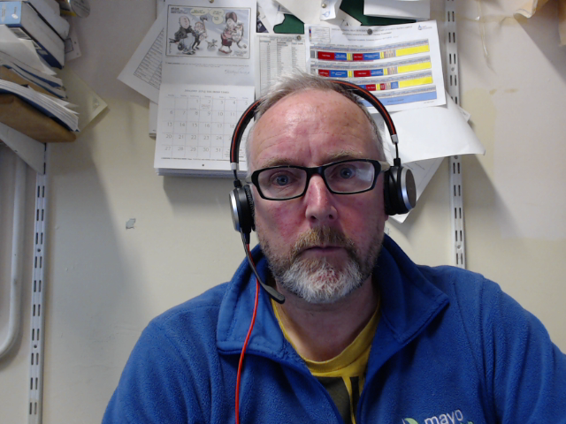
Week03 WeB Scraping
Andrew Beatty
Andrew.Beatty@gmit.ie
Data Representation

Slide 2

Overview
HTTP: First Lecture, more in coming weeks
URLs
Using Python to extract information from a web page
Small Assignment (will appear late on Thursday in moodle)
Lab

Slide 3
